Slide 1
Advanced Digital Design Techniques
Guided by:
• Dr. Y.V. Joshi
• Dr. S.S. Gajre
Subject Teacher:
• Mr. Vaibbhav Taraate
Team members:
• Mukul Lokhande

Slide 2
Contents
Clocks
Timing Analysis
Data Integrity
Synchronization

Slide 3
Clocks: Why ?
For regularity in sequential circuits
Execution of events according duty cycle
Types:
Oscillator
Gated clock
PLL

Slide 4
Why Multiple Clocks
Inherent clock Sources: External links with different frequencies
Circuit size: Clock skew increases with larger system
Design Complexity: Different parts with different operating frequencies
Power Consideration: To reduce dynamic power

Slide 5
Clock System
a)Independent clocks: Asynchronous
Relationship between clocks is unknown
b)Derived clocks: Synchronous
Clock derived from another clock signal ( different clock rate or phase)
Known Relationship between two signals
Typical implementation can be done with integer multiples of frequency
Eg: 200 MHz bus and 800 MHz processor
–Logic for the derived clock should be separated from regular logic and manually synthesized ( special delay line or PLL)

Slide 6
Clock Distribution Network
•Ideal clock: clock’s rising edge arrive at FFs at the same time
•Real implementation:
–Driving capability of each cell is limited
–Need a network of buffers to drive all FFs (more effort and power)
–Must balance the length of clock signal wire
a)FPGA: Pre-fabricated clock distribution network. Easy to use.
b)ASIC: Clock tree. Implementation needs attention.

Slide 7
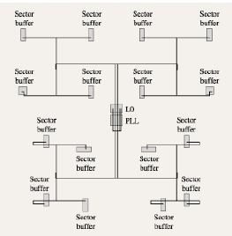
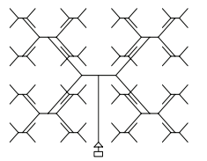
Clock Distribution
H tree
X tree
3. Multi Level clock tree
4. Fish bone

Slide 8
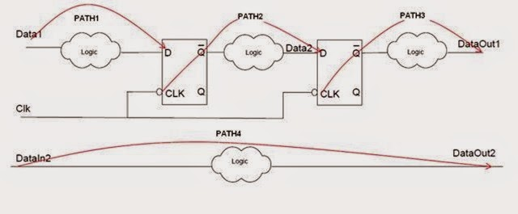
Timing Paths
Input to Register
Register to Register
3. Register to Output
4. Input to Output

Slide 9
Slack
Slack = Required time – Arrival time
Positive slack : Design is meeting the timings at desired frequency
Zero slack : Design is critically working at desired frequency
Negative slack : Design has not achieved the specified timings

Slide 10
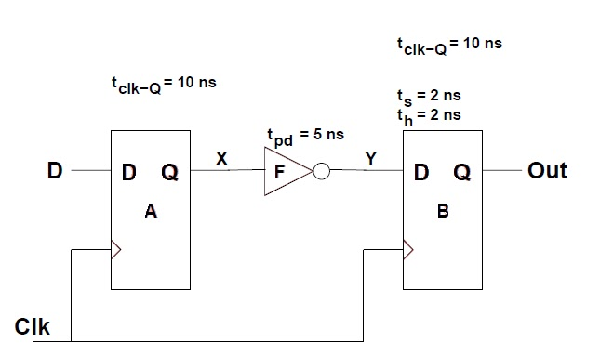
Slack
Ex. t_{clk} = 20 ns
Slack = Required time – Arrival time
Required time = t_{clk} - t_{su}
= 20 – 2 = 18 ns
Arrival time = t_{clk-q} + t_{pd}
= 10 + 5 = 15ns
Slack = 3 ns

Slide 11
Data Integrity
Data Integrity is a issue incurred in the digital design during multiple clock domain system is required.
The term refers to the propagation of invalid data in the multiple clock domain system.
The issue arises due to the major issue of metastability at the clock domain crossing boundaries.

Slide 12
Clock Domain Crossing
Traversal of a signal in a synchronous digital circuit from one clock domain to another.
Example –
Earlier the CPU chip ran in its own single clock, now modern CPU chip have such a high speed clock that designers are forced to create several different clock domain on a single chip.
This can cause serious design failures.
They can be avoided by following the critical design guidelines and using well established verification techniques.

Slide 13
Clock Domain Crossing
Different clock domains have clocks of different frequencies or different phases.
In either case, the relationship between the clock-edges can not be relied upon.
These clock domain crossing boundaries are formed due to :
Transfer of data between two different chips running at their own clocks.
In some cases clock gating also results in formation of clock domain crossing boundary.
The serious issue caused by the clock domain crossing is the synchronization failures.
It occurs due to the asynchronous behaviour of the system.

Slide 14
Synchronization failure
A signal generated in one clock domain is sampled too close to the rising edge of a clock signal from a second clock domain.
Output signal going metastable and not converging to a legal stable state by the time the output must be sampled again.
The synchronization failure can be minimized by the use of the synchronizer circuit.
Synchronizer: a device that samples an asynchronous signal and outputs a version of the signal that has transitions synchronized to the sampling clock domain.

Slide 15
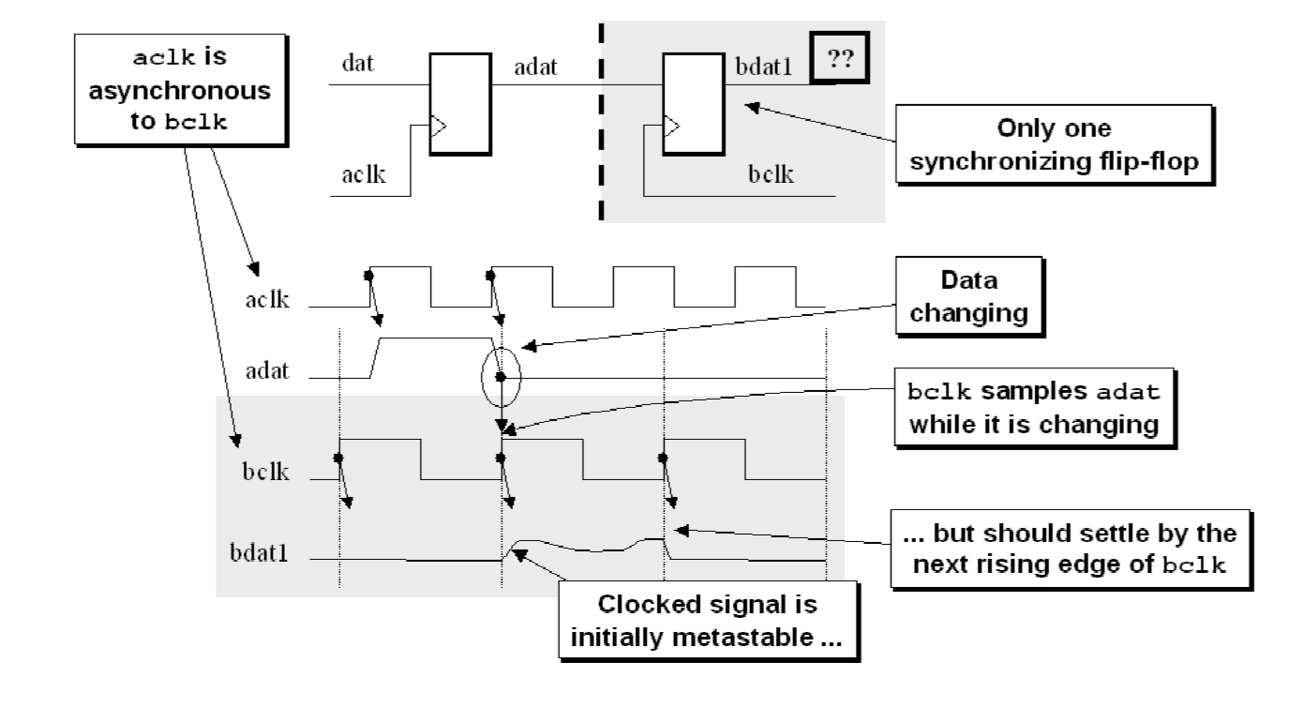
Synchronization failure

Slide 16
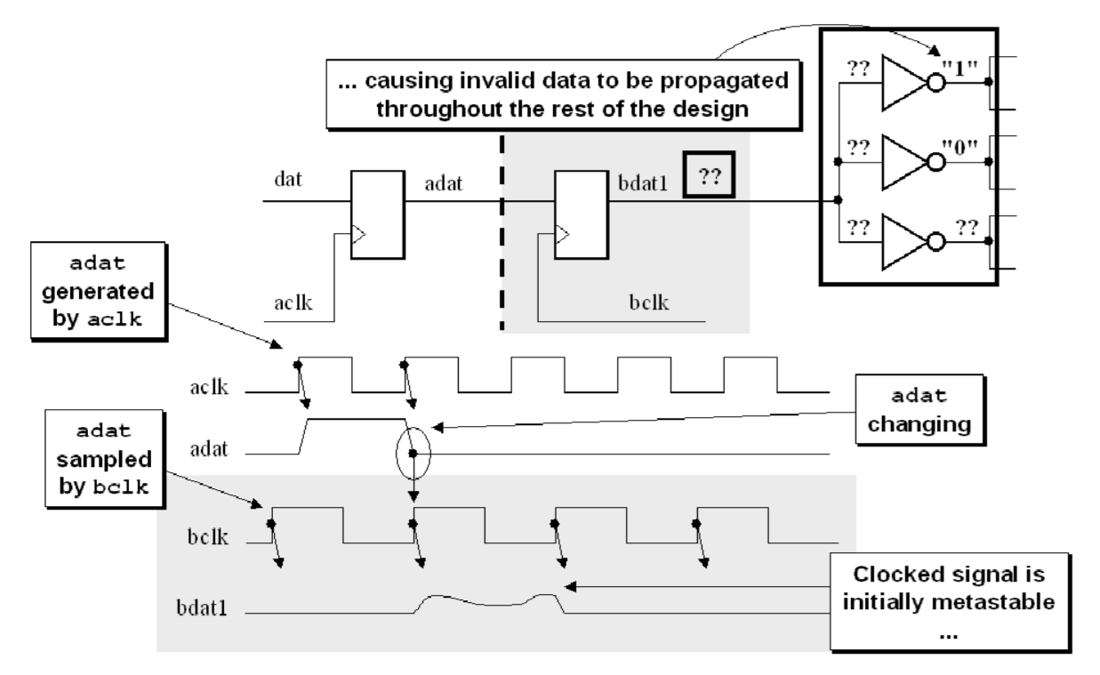
Need of Synchronizer
Metastability caused due to the synchronization failures.
Which in turn causes propagation of illegal data values throughout the rest of the design.
It is used to reduce the chances of the system undergoing metastable state.
Propagation of invalid data to the inputs of the receiving clock domain

Slide 17
Synchronizer Types
Pulse Synchronizer
Mux Synchronizer
Handshaking
FIFO based Synchronizer

Slide 18
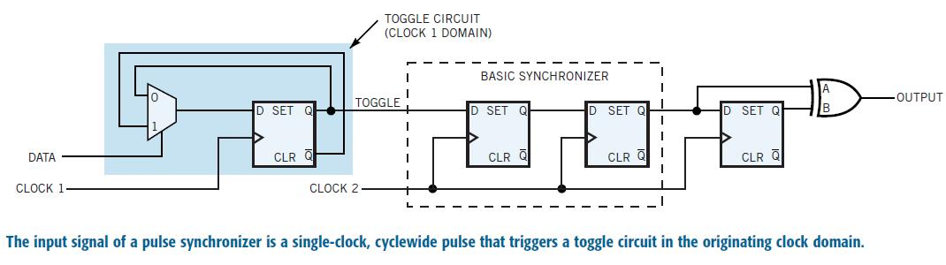
Pulse Synchronizer

Slide 19
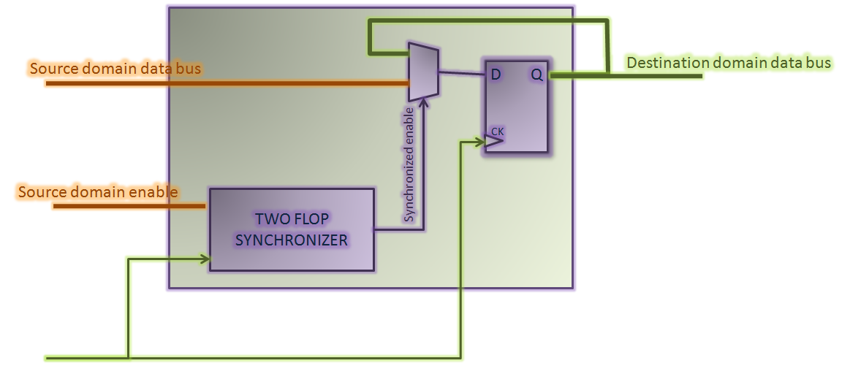
MUX Synchronizer

Slide 20
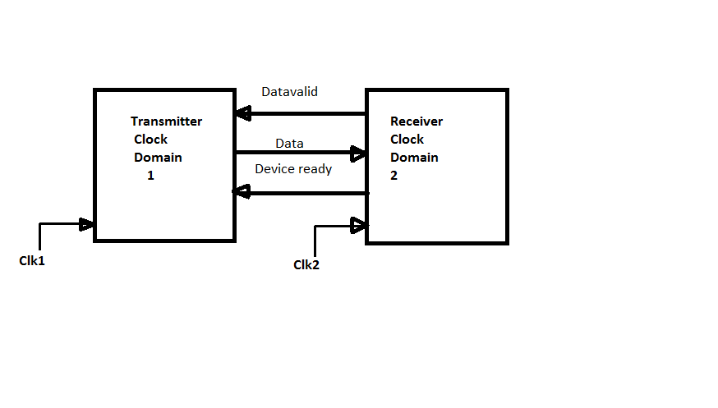
Handshaking

Slide 21
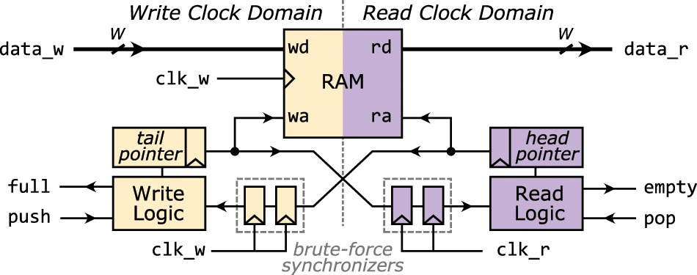
FIFO Based Synchronizer

Slide 22
Thank You..!

